Slide 1
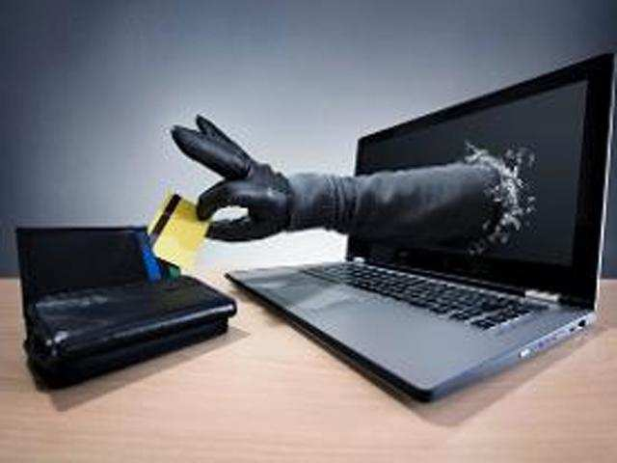
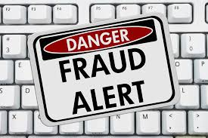
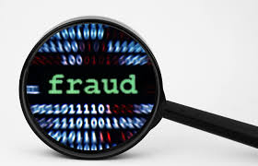
Credit Card Fraud Detection using Machine Learning
-By Gayatri Pingale

Slide 2
Why I chose this topic?
47% of the Global Credit Card Frauds, occurs in Americans in the past 5 years exceeding the loss of $24 billions.
Older people, over age 50yrs are victimized more than younger people
Most of the time, the victim will end up loosing money directly or indirectly.
Media loss was $2000, and, the average loss was about $8,000.
Notes:
While browsing different topics for our project-3, I came across one article on Motely Fool that about 46% of Americans have fallen victim to the Credit Card Fraud in the past 5 years, and it is estimated that the losses occurred exceeds $24 billions in 2016.

Slide 3
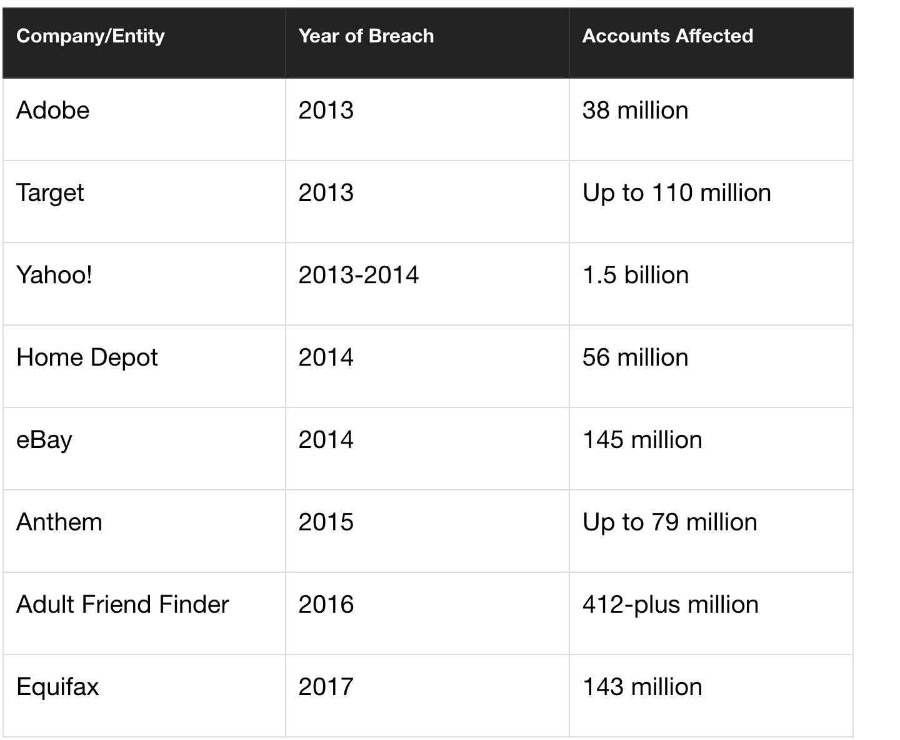
Here are some examples of biggest breaches in recent years
Breached reported in mid 2015-mid 2016
Global Breaches: 1800+
Reported in US alone: Approx 1100
Notes:
You are on hook for up to $50 only, and, cc companies and bank hook for the rest of whatever was charged.

Slide 4
.textClipping

Slide 5
Curiosity
How do the Credit Card Companies Detect the Fraud?

Slide 6
The key way the companies detect the fraud by:
Looking unusual Activity
Your spending habits
What town and Region you spend money in
Amount you tend to charge
The stores you frequently go to etc.
Notes:
So if you live in Georgia but all of a sudden the company spots transactions happening in a distant location, such as Minnesota, it might decline the next transaction until it gets verification that you're really behind the charge.
Similarly, if you typically charge between $1,000 and $2,000 per month and there's suddenly a $4,500 charge, the card company may well refuse the transaction or require you to verify it.

Slide 7
Solution
Technology
Fraud
Humanity

Slide 8
The solution to minimize the frauds
Use of both technology and humanity to fight Fraud
Technology: Employing the automated fraud detection algorithms across massive amount of datasets of cards and customers
Humanity: If the transaction is flagged as the possible fraud, a human can follow up, contacting the customer.
Note: Even Humanity part is increasingly automated now a days by sending texts to verify the suspicious activity on the card
Notes:
Credit card companies use a combination of technology and humanity to fight fraud, employing automated fraud detection algorithms across massive amounts of data collected from millions of customers and hundreds of millions of cards

Slide 9
The Credit Card Fraud Detection Problem statement
It includes modeling the credit card transactions with knowledge of ones that turned out to be Fraud.
Use this model to identify whether the new transaction is Fraudulent or not.
Our aim Is to detect 100% Fraudulent transaction while minimizing incorrect fraud classification

Slide 11
Combat fraud with the Pandas

Slide 13
Thanks
BIG Thanks to Carlos, Clayton, Nick, Seth, Kayne for your gigantic help on everything- right from the complex concepts to tiney-tiney things.
Thanks to all classmates who helped me directly/indirectly
I had so much fun in this class, an, I learn so many new things
Notes:
I am getting sad that I won’t be able to see you any more.
Good luck for your future plans, wish you get a job that you are looking for soon.

